Slide 1
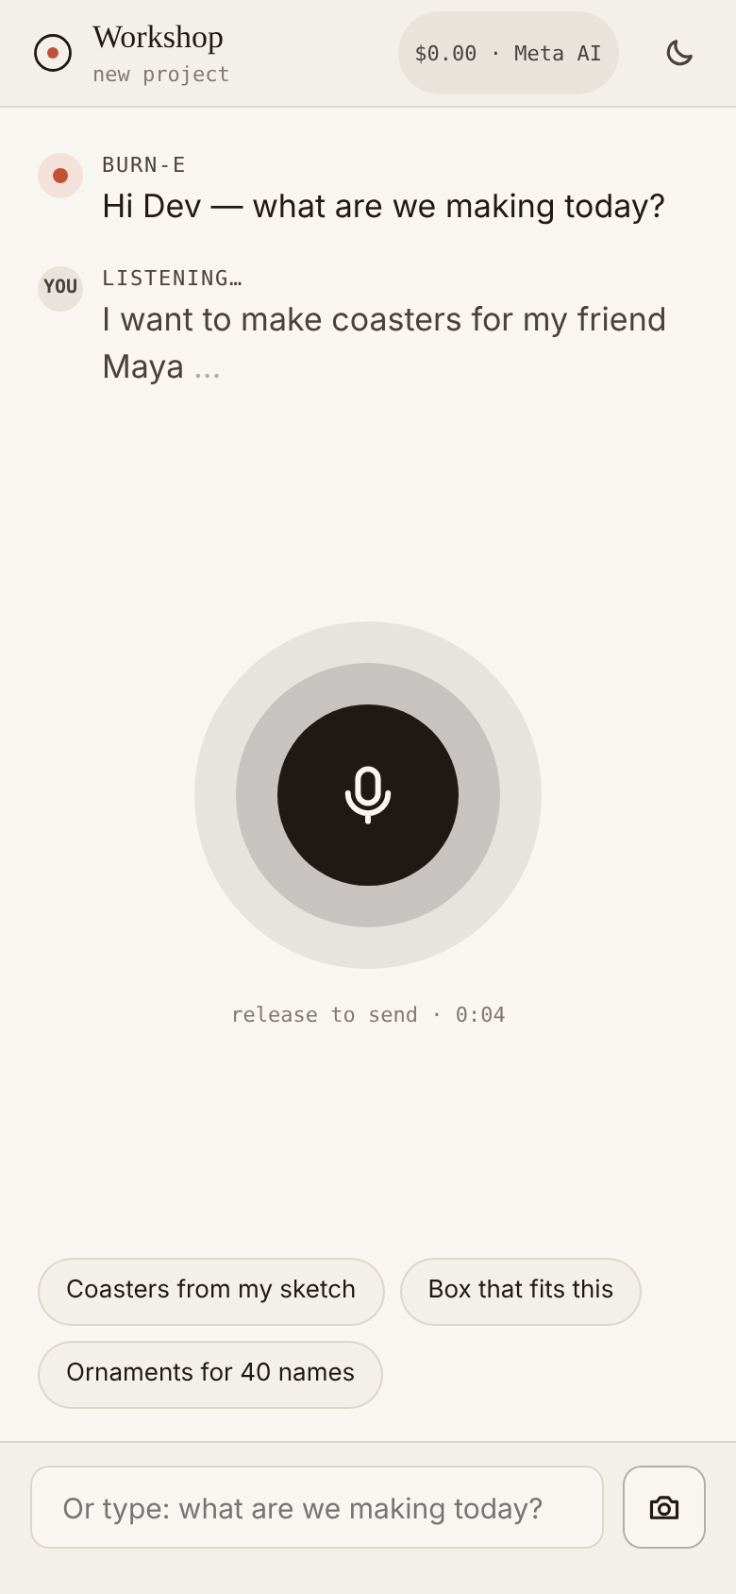
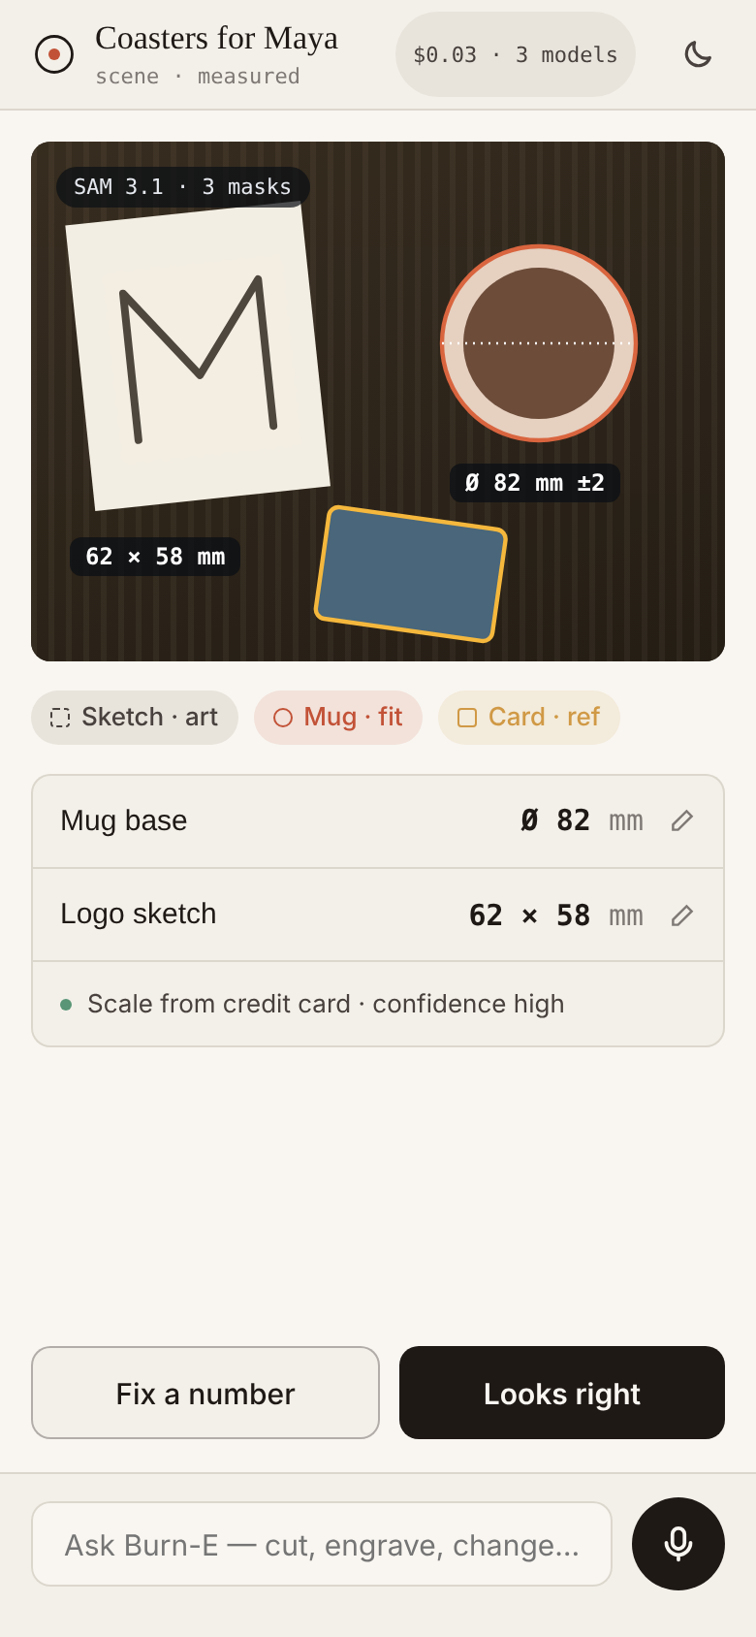
Show it.
Say it.
Burn it.
BURN-E · SNAP → MAKE · PHASE 1
A voice-first workshop buddy that turns a photo and a sentence into a measured, cut-ready design.
Meta Global AI Developer Hackathon · Oct 26 – Nov 4, 2026
Notes:
Burn-E Snap to Make. Point your phone at a sketch and the thing it has to fit, say what you want, and Burn-E measures, designs the parts, previews the result and writes the G-code, then watches the burn. This deck walks the Phase 1 hero journey screen by screen.

Slide 2
Millions own a laser or a Cricut.
The design step is the wall.
THE PROBLEM
01
02
03
04
Measure
Trace
Imagine
Watch
Carrying the mug, the shelf gap or the phone into a vector editor by hand.
Hand sketches redrawn point by point, or fed to brittle auto-trace.
No idea how it will look until real material is burned.
Burns run unattended; flare-ups and missed cuts are found too late.
So most machines cut the same downloaded templates — and many sit idle.
Burn-E · Snap → Make · 02
Notes:
The hardware is easy now. The design step is the wall: measuring the real world, tracing sketches, imagining the result and watching the burn are all manual today. Burn-E takes on all four.

Slide 3
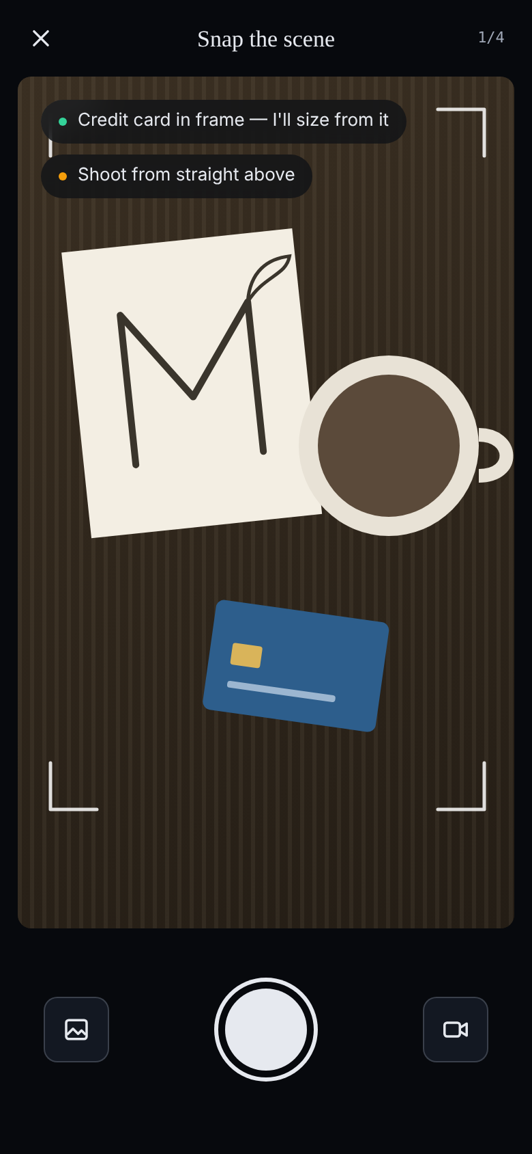
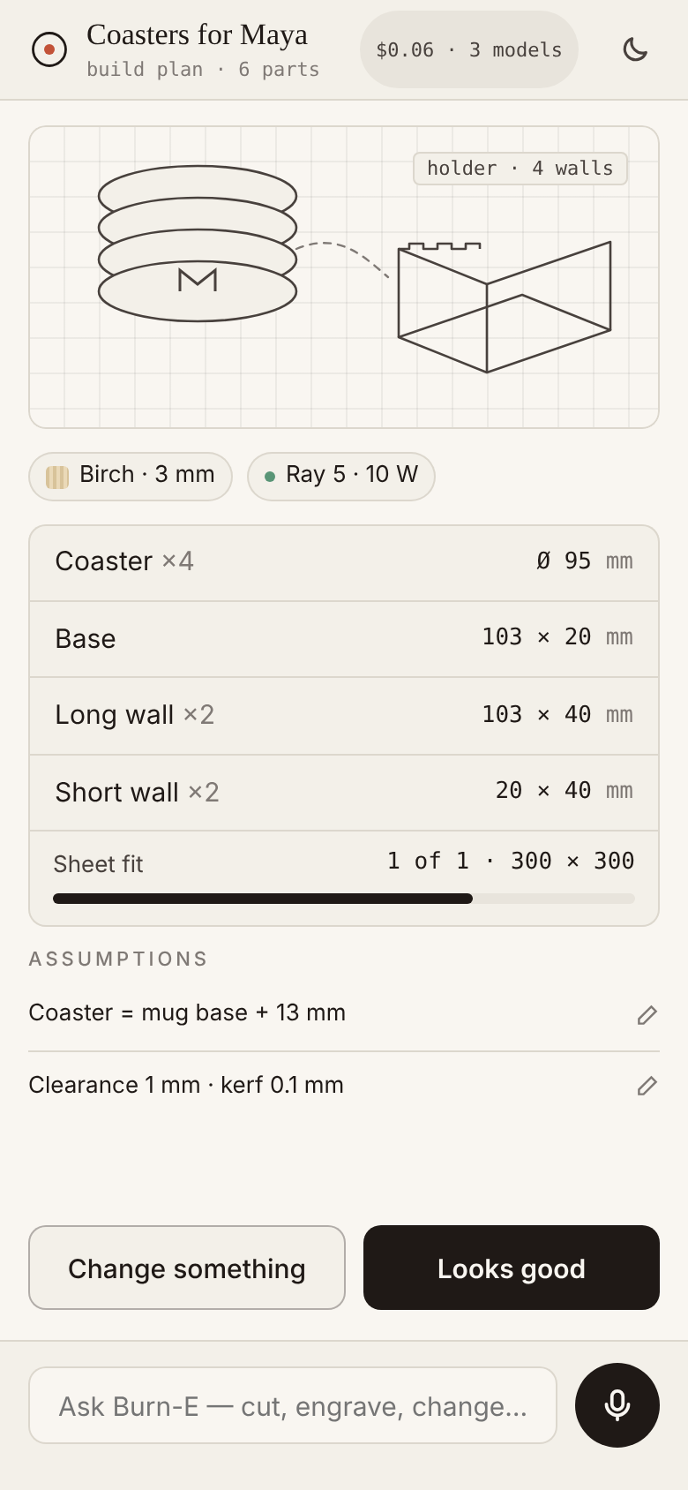
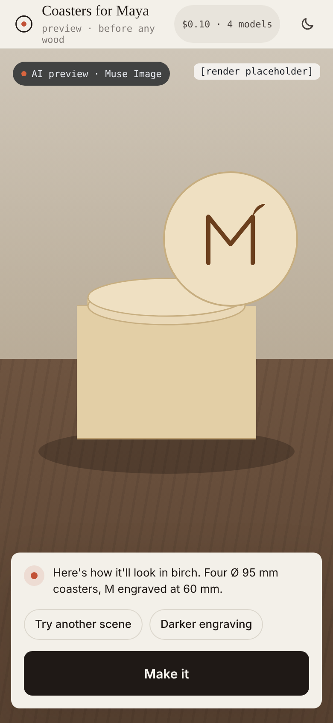
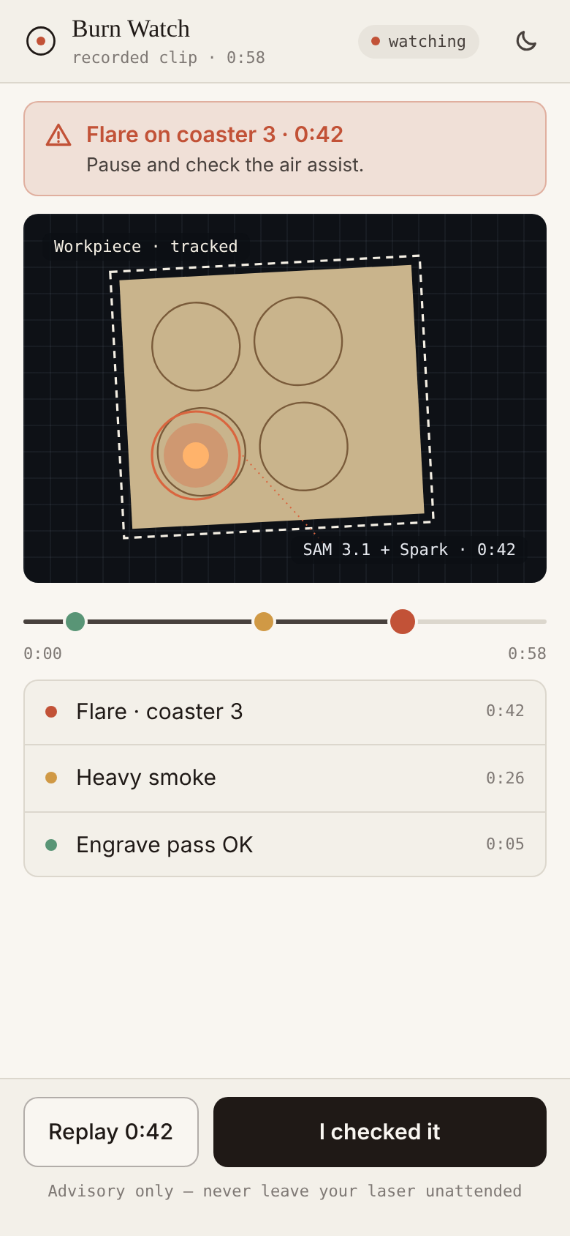
Coasters for Maya, in four beats.
THE HERO JOURNEY
10 screens · under 5 min
01 · SHOW IT
02 · SAY IT
03 · SEE IT
04 · BURN IT
One photo of the bench; masks measure it.
A spoken request becomes a parts plan.
Clean art and a preview before any wood.
G-code out, and a second pair of eyes.
Burn-E · Snap → Make · 03
Notes:
The demo is one hero journey: Dev, a hobby maker with a Longer Ray 5, makes four coasters and a finger-jointed holder for his friend Maya. Show it, say it, see it, burn it: ten phone screens, under five minutes of software time, ending with a physical object on camera.

Slide 4
One photo.
Measured, not guessed.
01 · SHOW IT
Dev snaps the sketch, the mug and a credit card. Burn-E names each object and outlines it, then sizes everything against the card.
Spark 1.3
reads the scene: art, fit target, reference
SAM 3.1
pixel-exact masks for each object
Code
px/mm from the card → mug base Ø 82 mm ±2
Burn-E · Snap → Make · 04 · screens 03–04
Notes:
Show it. One photo with a reference card. Spark 1.3 returns a SceneAnalysis: which object is the art, which is the fit target, which is the reference. SAM 3.1 outlines each one, and plain code computes the scale and the mug diameter, so the number is measured rather than guessed by a language model. Every number is tappable to correct. Target accuracy is plus or minus 3 percent with the card in frame.

Slide 5
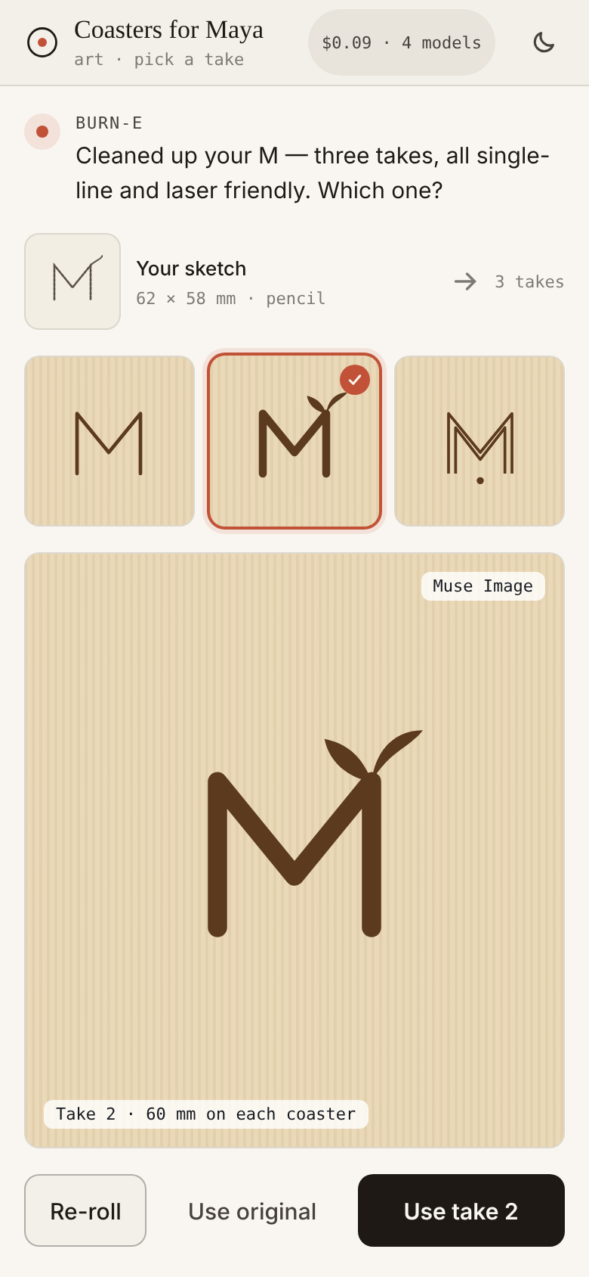
A sentence becomes a parts plan.
02 · SAY IT
“Four coasters, a bit bigger than the mug, 3 mm birch, with a finger-joint holder.” Six parts, one sheet — with every assumption shown and editable.
Spark 1.3
picks templates and writes a strict DesignSpec
Code
builds exact geometry, joints, kerf, nesting
Muse Image
cleans the sketch into three laser-friendly takes
Burn-E · Snap → Make · 05 · screens 05–06
Notes:
Say it. Spark 1.3 turns intent plus measurements into a DesignSpec: parts, joints, engraving, sheet and material. The model never emits coordinates; a deterministic generator builds the geometry. Assumptions such as coaster equals mug base plus 13 millimetres sit on the plan card so Dev can correct them. Muse Image cleans the pencil sketch into three engraving-ready variants and Dev picks one.

Slide 6
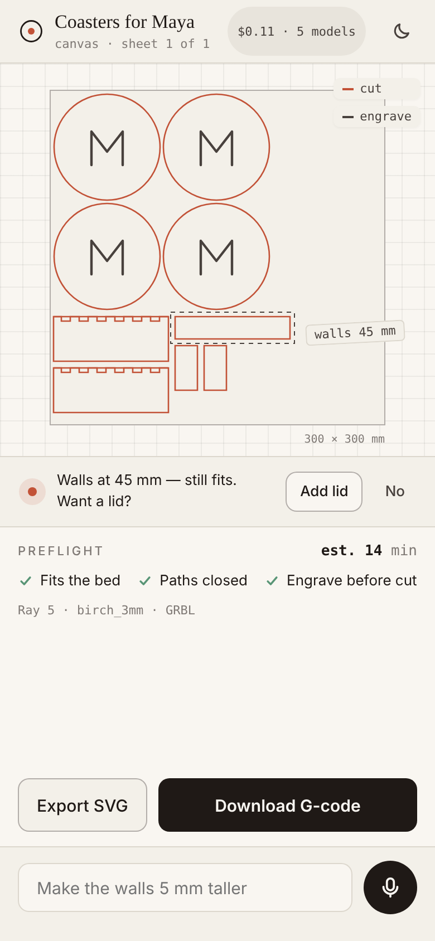
See the finished piece before any wood is cut.
03 · SEE IT
A photoreal preview in the chosen material, labelled as an AI preview. “Make it” turns the plan into real parts on the sheet, and voice edits keep working.
Muse Image
art + birch swatch + scene → one render
Spark 1.3
“walls 5 mm taller” → a canvas edit
Burn-E · Snap → Make · 06 · screens 07–08
Notes:
See it. Muse Image renders the finished object from ordered references: the chosen art, a birch material swatch and an optional scene. It is always labelled as an AI preview. Make it opens the canvas with real parts nested on the sheet, engrave in ink and cut in vermillion, and Spark maps voice edits like make the walls 5 millimetres taller to canvas operations.

Slide 7
One tap to G-code. A second pair of eyes on the burn.
04 · BURN IT
Preflight checks the bed, the paths and the order. Propped against the machine, the phone watches the burn and flags flare-ups — advisory only.
Code
GRBL G-code or SVG for Cricut and Glowforge
SAM + Spark
track the workpiece, flag flare and smoke
Burn-E · Snap → Make · 07 · screens 08–09
Notes:
Burn it. The existing G-code generator runs with the device and material preset; engraving runs before cutting. Burn Watch uses SAM 3.1 video tracking and Spark 1.3 to flag flare-ups, heavy smoke, a shifted workpiece or an incomplete cut. In Phase 1 it runs on a recorded clip; it is always advisory and never claims safety.

Slide 8
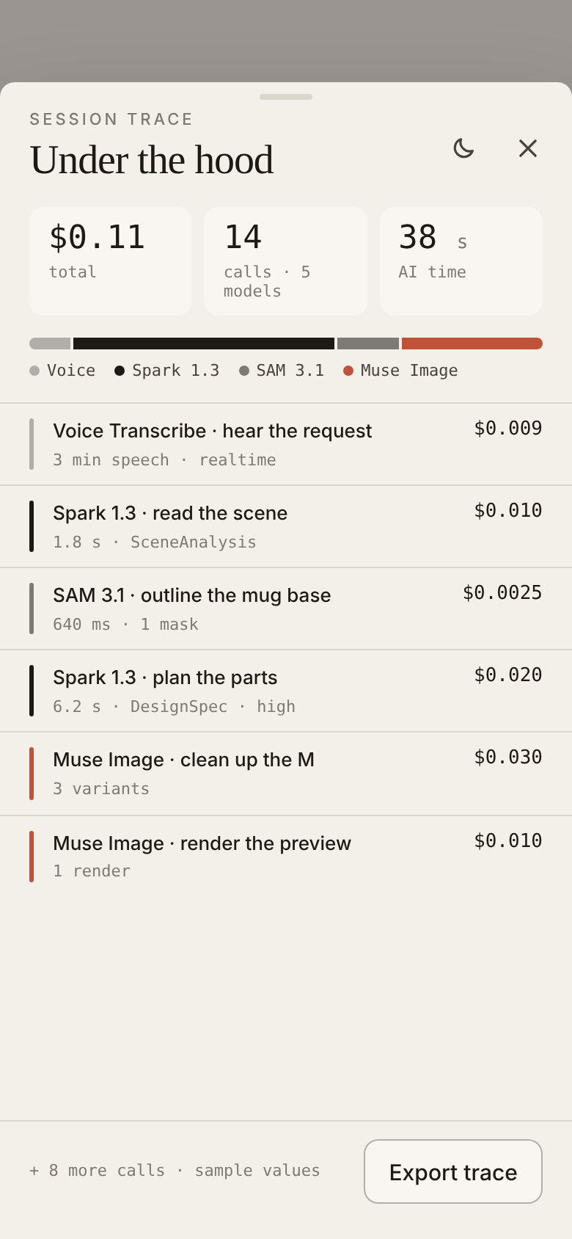
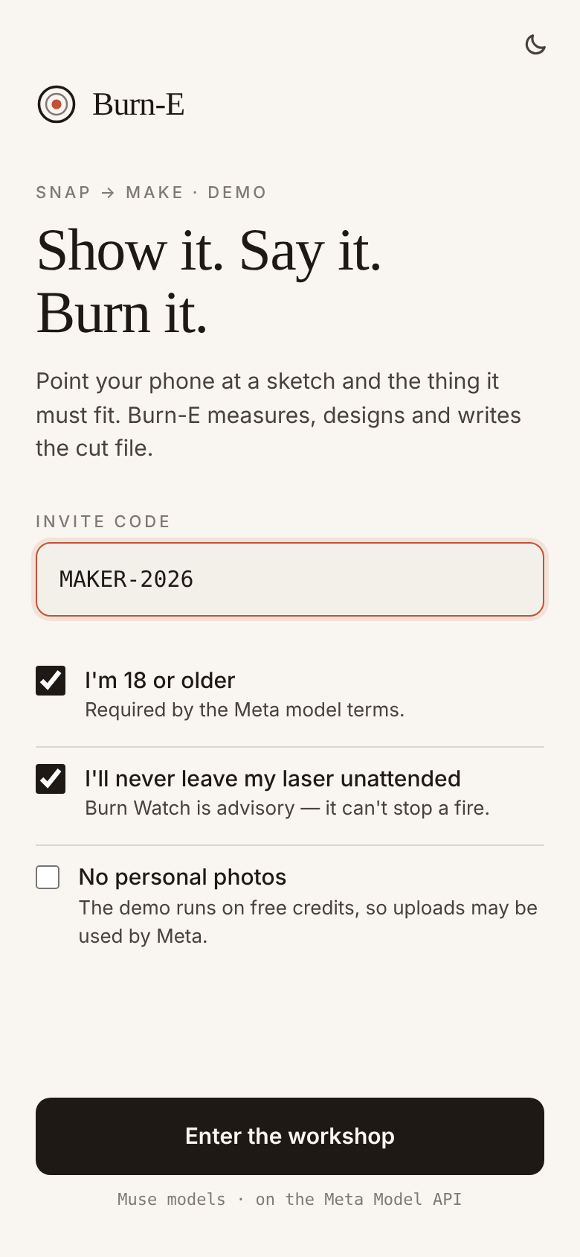
Every model call, its job and its cost — on screen.
UNDER THE HOOD
≈ $0.13
≈ 1,000
per hero session, 5 models
sessions from $150 of credit
$1 · $10
18+
budget caps per session · per day
invite code, safety and media notice
Burn-E · Snap → Make · 08 · screens 10 and 01
Notes:
Judges can open Under the hood at any point: every model call with its purpose, latency and cost, exportable as JSON for the white paper. The PRD’s cost model puts a hero session at about 13 cents, so 150 dollars of hackathon credit covers about a thousand sessions. All Meta calls go through the server, with budget caps and a kill switch, and the first-run gate covers the invite code, the 18-plus terms, laser safety and the free-credit media notice.

Slide 9
Six Meta models, one workshop buddy.
WHY META’S MODELS
Voice Transcribe
The ear — realtime push-to-talk, biased to maker words
P1
Muse Spark 1.3
Eye and brain — scene, plan and edits as strict JSON
P1
SAM 3.1
The steady hand — masks for scale, fit, art and tracking
P1
Muse Image
Imagination — sketch cleanup and the photoreal preview
P1
Muse Wonder
Project manager — 40-name batches, in the background
P1+
Muse Glimmer
Offline shop copilot, open weights, running locally
P1+
Models perceive, reason and imagine. Code measures and builds geometry. Built with Muse Code.
Burn-E · Snap → Make · 09
Notes:
Each step needs a different kind of intelligence, and each Meta model does the one it is best at. Voice Transcribe listens, Spark sees and reasons, SAM traces, Muse Image imagines, Wonder runs long batch jobs in the background and Glimmer is the offline copilot. Plain code does everything that must be exact. The implementation itself is driven by Muse Code from the PRD.

Slide 10
From spikes to submission.
NINE DAYS
each day ends with a demo clip
D0 · 10/26
D1 · 10/27
D2 · 10/28
D3 · 10/29
D4 · 10/30
Orientation
Spikes
Geometry
UI flow I
UI flow II
PRD frozen, keys, 10 caliper-checked photos
Photo → masks → mm within ±5%
Templates and nesting; valid G-code
Voice → photo → measured plan
Full journey end to end · feature freeze
D5 · 10/31
D6 · 11/1
D7 · 11/2
D8 · 11/3
D9 · 11/4
Wow layer
Polish
Real burns
Story
Ship
Burn Watch, Wonder batch, public URL
Theme, motion, eval table
Burn and film the hero project
3-min video, deck, white paper
Submit by noon ET
Burn-E · Snap → Make · 10
Notes:
Nine days, each ending with a short recorded clip that becomes raw material for the video. Day 4 is the feature freeze: the whole hero journey must run end to end. Days 5 and 6 add Burn Watch, the Wonder batch job and polish, day 7 is real burns and filming, day 8 is the story, and we submit by noon Eastern on November 4.

Slide 11
This chain is the pitch.
NEVER CUT
voice
→
scene
→
measure
→
DesignSpec
→
art + preview
→
canvas
→
G-code
→
under the hood
If behind, drop from the top
Watch closely
Glimmer offline copilot
Live Burn Watch — keep the recorded clip
Share card and multi-turn preview edits
Phone stand and sign templates
Wonder batch → a “coming next” slide
Measurement accuracy. Card required, editable numbers; the day-1 spike sets the claim.
Scope. Nine days; freeze at the end of day 4.
Non-Meta parts. Browser speech and potrace — confirm the rules.
Burn-E · Snap → Make · 11
Notes:
Whatever happens, the chain from voice to scene, measurement, DesignSpec, art and preview, canvas, G-code and the under-the-hood view ships, because that chain is the pitch. If we fall behind we cut from the top of the list. The risks to watch are measurement accuracy, scope in nine days, and whether non-Meta components such as browser speech and potrace are allowed.

Slide 12
Show it. Say it.
Burn it.
BURN-E · SNAP → MAKE
From what you see and say to something you can hold.
submit by noon, Nov 4
Notes:
Close on the finished coasters next to the original sketch. Six Meta models, one workshop buddy: from what you see and say to something you can hold. Submission is due by noon Eastern on November 4.

